Slide 1
Use Case Description
Tim Teaching ADBO 2024

Slide 2
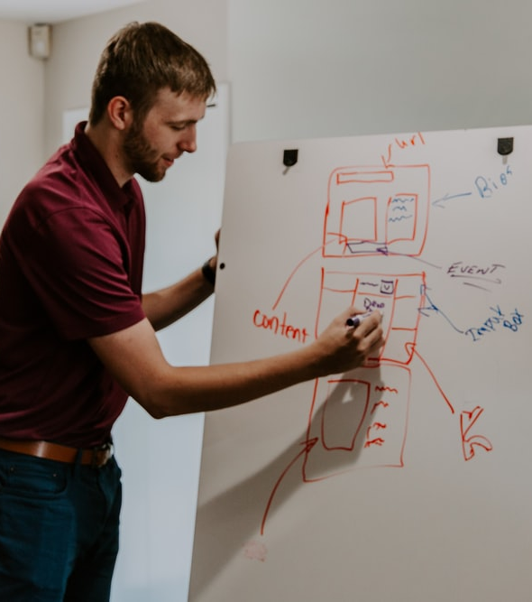
Use Case Description
Use case description berisi semua informasi untuk membangun struktur (structural) dan perilaku (behavioral) diagram.
Mengungkapkan informasi dengan cara less-formal.
Memiliki 3 bagian dasar:
Informasi ikhtisar (overview)
Hubungan (relationship)
Aliran peristiwa (flow of events)

Slide 3
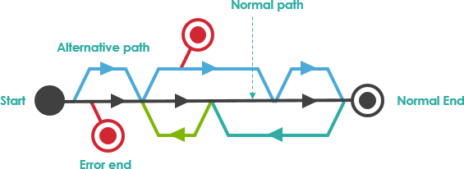
Use Case Description Illustration
Taken from visual-paradigm.com

Slide 4
Use Case Diagram Anatomy
Examples

Slide 5
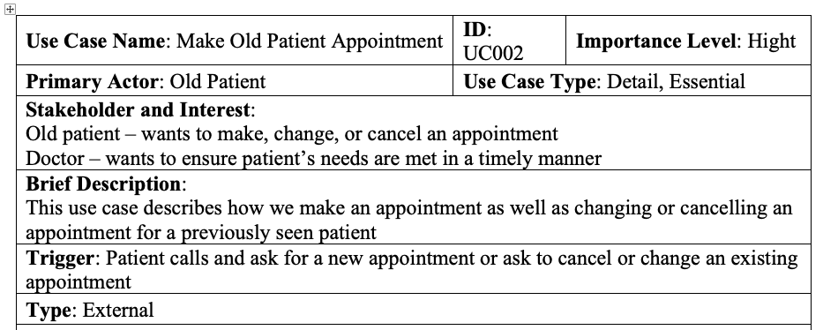
Use Case Diagram – Overview Information (1)

Slide 6
Use Case Diagram – Overview Information (2)
Use case name → Frasa verb-noun
Use case ID → ID unique untuk setiap use case
Use case type → jenis use case (overview/detail and essential/real)
Primary actor → Actor yang men-trigger use case
Brief description → Umumnya berupa kalimat Tunggal yang menggambarkan deskripsi dari use case
Importance level → Prioritas level dalam use case (high, medium, low)
Stakeholder → Siapa pun yang berkaitan dengan use case. Selalu menyertakan primary actor
Trigger → Pemicu yang menyebabkan use case dimulai.
External → Ex: Patient create an appointment
Temporal → Internal trigger or time based. Ex : generate monthly report

Slide 7
Use Case Types
Use Case
Purpose
Amount of Information
Overview
Detail
Essential
Real

Slide 8
Use Case Type: Purpose
Overview
Used to enable the analyst and user to agree on high-level overview of the requirements
All information needed for the use case. It can be based on the activities in the activity diagram
Detail
Notes:
Overview doesn’t contain flow of events

Slide 9
Use Case Type: Amount of Information
Describes only the minimum essential issues necessary to understand the required functionality
Essential
Real
Describes specific set of steps
Notes:
For example:
Essential → Patient want to make an appointment. The receptionist should attempt to match the patients desired appointment with the available times
Real → Look on the available time using calendar and so on, more technical.

Slide 10
Use Case Trigger
External Trigger: suatu peristiwa atau kondisi di luar sistem yang memicu tindakan atau proses dalam sistem.
Temporal Trigger: pemicu yang didasarkan pada waktu.

Slide 11
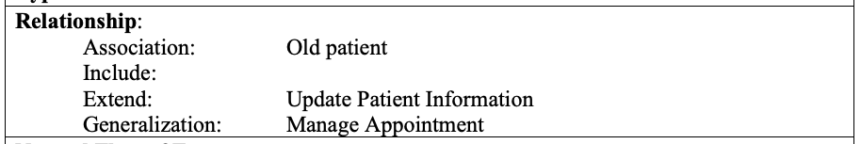
Use Case Diagram – Relationships

Slide 12
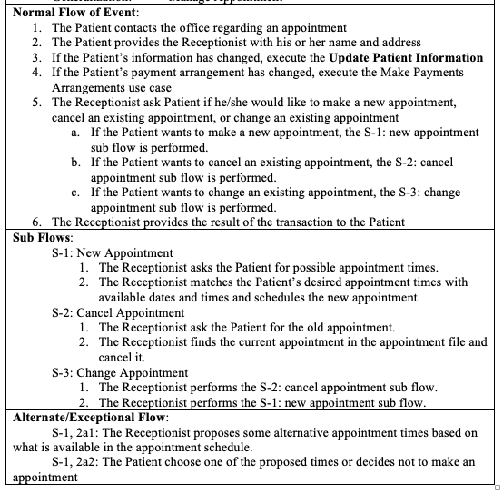
Use Case Diagram – Flow of Events (1)

Slide 13


Use Case Diagram – Flow of Events (2)
Normal (Basic) flow of event → Steps that normally are executed in a use case
Alternative or exceptional flows → Ones that do happen but are not considered to be the norm

Slide 14
Back to our online bookstore
Refine, refine, and refine

Slide 15
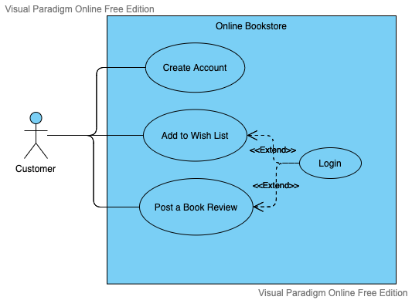
Online Bookstore: The Use Case Diagram

Slide 16
Online Bookstore: The Use Cases
The customer enter id, name, address, email, and password, to create a customer account and then click create account button. The system looks up the master account list. If the customer doesn’t exist, the system will add the customer account to master account list.
The customer select a book and adds it to his wish list. The system display the updated wish list page and display the customer’s shopping chart.
The customer able to post a book review. The system will show the reviews on the book detail page.

Slide 17
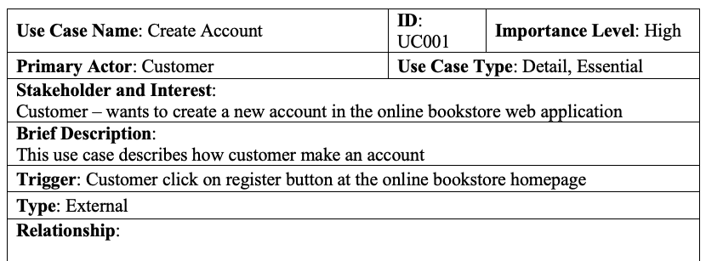
The Use Case Description of Create Account (1)

Slide 18
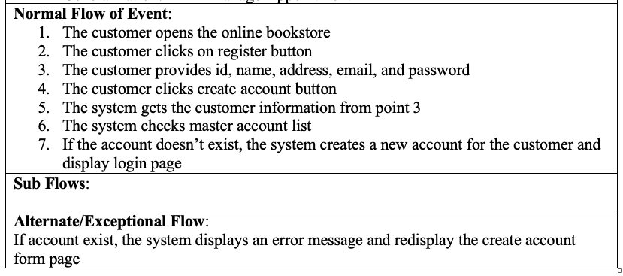
The Use Case Description of Create Account (2)

Slide 19


